Slide 1
COMP 53 – Week Fourteen
Trees

Slide 2
Data Structures
Data Structures
Linear
Direct Access
Sequential Access
Nonlinear
Hierarchical
Array
List
Stack
Queue
Hashtable
Tree
Heap

Slide 3

Topics
Project Five Preview
Tree Overview
Tree Traversal
CRUD Operations

Slide 4
Why Do We Care
Need to Know Trees!
On the final
VERY Common data structure in programs
Foundational concept of data organization

Slide 5
Trees Introduction
Trees are complex data structures
Recall linked list: nodes have only one pointer → next node
Trees have two, & sometimes more, pointers to other nodes
Trees are normally created in sorted order
Trees may need to be rebalanced → expensive operation

Slide 6
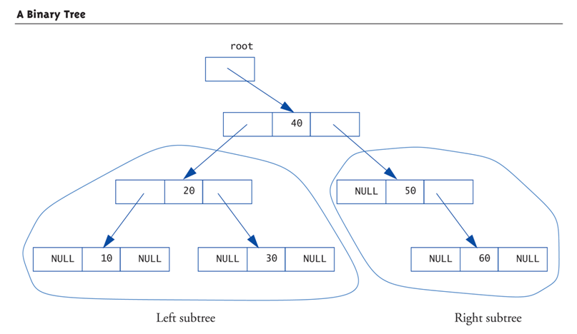
Binary Tree Diagram
Note that the data elements are sorted with smaller items to the left
Trees consist of subtrees → naturally recursive
Notes:
Storage Rules:
All values in left sub-tree < root
All values in right sub-tree ≥ root
Same is true of roots of each sub-tree

Slide 7
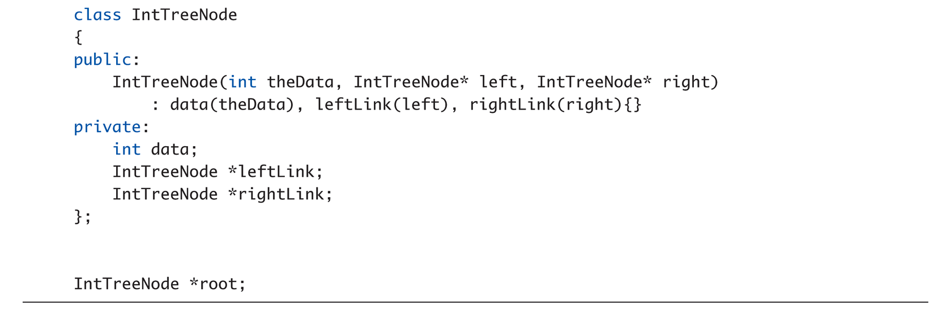
Binary Tree Data Structure

Slide 8
Tree Properties
Notice paths
From top to any node
No "cycles" – follow pointers, will reach "end"
Notice here each node has two links
Called binary tree
Most common type of tree
Root node
Similar to linked list’s head
Leaf nodes
Both link variables are NULL (no subtrees)

Slide 9
Tree Processing Options
Preorder Processing:
Process data in root node
Process left subtree
Process right subtree
In-order Processing:
Process left subtree
Process data in root
Process right subtree
Postorder Processing:
Process left subtree
Process right subtree
Process data in root
Binary Search Tree:
Traversals:
Inorder → values "in order" Preorder → "prefix" notation Postorder → "postfix" notation
Natural Data Structure for Recursion

Slide 10
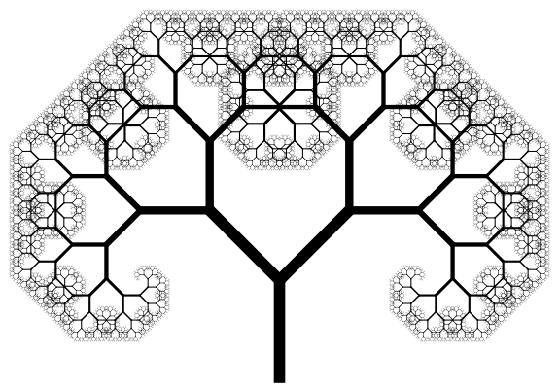
Balanced Tree
There are the same number of leaves on each side of the root
Recursive definition – the left/right root has same number of leaves on each of its side.
Optimal for searching → O(log n) processing

Slide 11
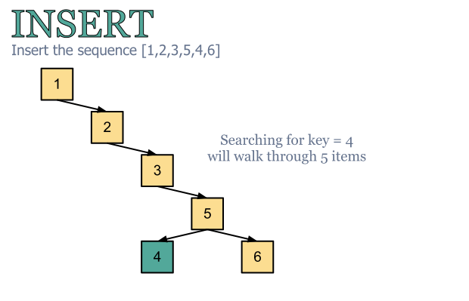
Unbalanced Binary Tree
Natural sort process will keep inserting to the right
Worst case search is O(n) – same as linked list

Slide 12
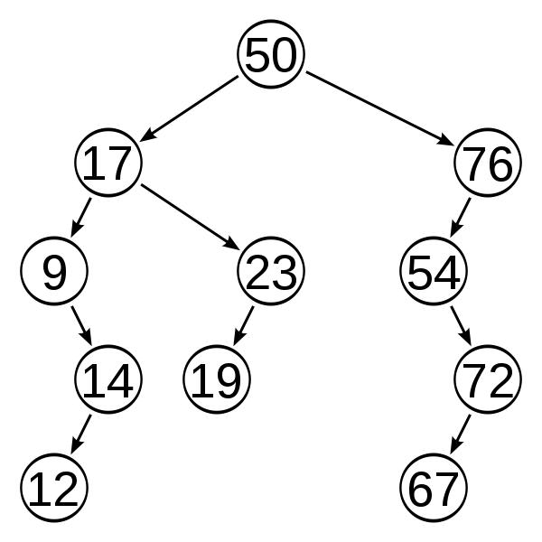
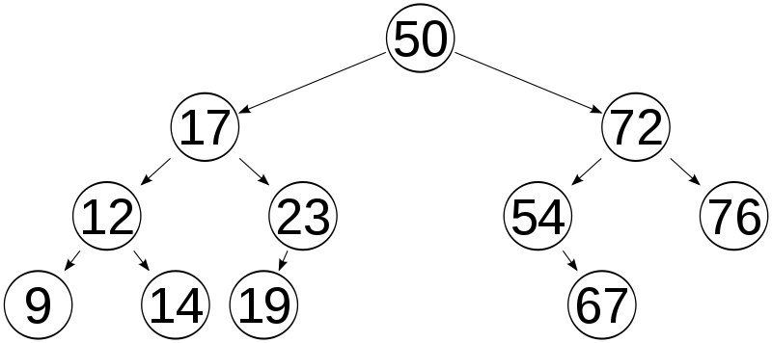
Re-Balancing is Required
Go through a process of pivot and rotate at each node

Slide 13
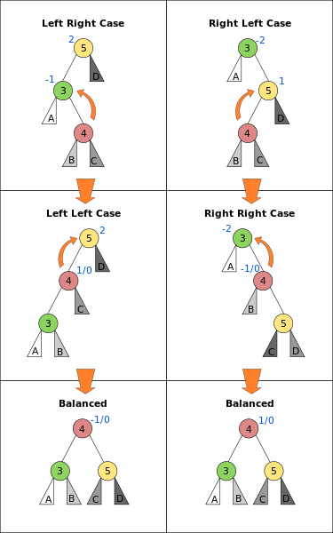
AVL Balancing Algorithm Insertion
Calculate a balance factor for each node
= height of left subtree – height of right subtree
A tree is considered balanced when
-1 < height < 1
Work your way down to tree to find where imbalance starts
Then pivot node to become new root
Notes:
Taken from - http://en.wikipedia.org/wiki/AVL_tree
(Adelson-Velskii and Landis' tree, named after the inventors)

Slide 14
Complete Binary Trees
First node remains the root
Second node is always to the left
And third is always to the right
Notes:
The next node must be the right child of the root.

Slide 15
Adding More Rows to Complete Tree
Next row starts at the left most leaf
And are added left to right
Notes:
...and the right child of Colorado.
Where would the next node after this go?...
By the way, there is also an interesting story about Idaho. Apparently congress decreed that the border between Idaho and Montana was to be the continental divide. So the surveyers started at Yellowstone Park, mapping out the border, but at “Lost Trail Pass” they made a mistake and took a false divide. They continued along the false divide for several hundred miles until they crossed over a ridge and saw the Clark Fork River cutting right across what they thought was the divide. At this point, they just gave up and took the rest of the border straight north to Canada. So those of you who come from Kalispell and Missoula Montana should really be Idahonians.

Slide 16
Final Result for Complete Tree
Notes:
Then the right child of Florida.

Slide 17
So What is so Great About Complete Tree
Minimizes space – only nodes allocated for required data
Minimizes the depth of the tree
Max tree height <= log N in size
Data is stored in order of addition to tree (root is oldest)
Lower right is newest

Slide 18
Is This Complete?
Notes:
Just to check your understanding, is this binary tree a complete binary tree?
No, it isn't since the nodes of the bottom level have not been added from left to right.

Slide 19
Is This Complete?
Notes:
Is this complete?
No, since the third level was not completed before starting the fourth level.

Slide 20
Is This Complete?
Notes:
This is also not complete since Washington has a right child but no left child.

Slide 21
Are These Complete?
Notes:
But this binary tree is complete. It has only one node, the root. The right hand side represents an empty tree. It is also considered complete.

Slide 22
Topics
Tree Overview
Tree Traversal
CRUD Operations

Slide 23
Printing a BST
What sort of traversal needed? Goal is to display the tree with sorted values.
34
19
50
1
21
46
87

Slide 24
Destructor
What order traversal do we need?
34
Big O?
19
50
1
21
46
87

Slide 25
Tree Practice (1 of 3)
Define a TreeNode Class with properties
T data;
TreeNode *lChild;
TreeNode *rChild;
Add the following methods
Default and General constructors
Destructor
Print() method

Slide 26
Insertion into a BST Interactive Tool
58
34
Big O?
19
50
1
21
46
87

Slide 27
Tree Practice (2 of 3)
Add the insertion method
Input parameter is an item to be added (data=item)
Recursively traverse the tree based upon the item value
if item < data
If left tree is null, add a new node
Else go to left tree pointer
If item > data,
If right tree is null, add a new node
Else go to right tree pointer
Notes:
End of Lecture 1

Slide 28
Searching a BST
What traversal is recommended?
34
Big O?
19
50
1
21
46
87

Slide 29
Tree Practice (3 of 3)
Add the search method
Returns true if item is found
Recursively search the tree based upon sorted value
If item < data recursively call the search with the left node
If item > data recursively call the search with the right node
Last statement should be return false

Slide 30
Deletion from a BST
Cases to Consider?
Item not in Tree / Tree Empty
Item is Root:
Node with 0 Children
Node with 1 Child
Node with 2 Children
Item is not Root:
Node with 0 Children
Node with 1 Child
Node with 2 Children

Slide 31
Deleting Node with 0 Children
21
34
19
50
1
21
46
87

Slide 32
Deleting Node with 1 Child
50
34
19
50
1
21
46

Slide 33
Deleting Node with 1 Child
50
50
34
19
46
1
21

Slide 34
Deleting Node with 2 Children
Which nodes could replace root?
34
34
19
50
1
21
46
87

Slide 35
Deletion from a BST
Which nodes could replace root?
34
34
19
50
1
21
46
87

Slide 36
Deletion from a BST
Which nodes could replace root?
34
46
19
50
1
21
87

Slide 37
Non-Binary Trees

Slide 38
Coding the Delete Practice
If there is time!

Slide 39
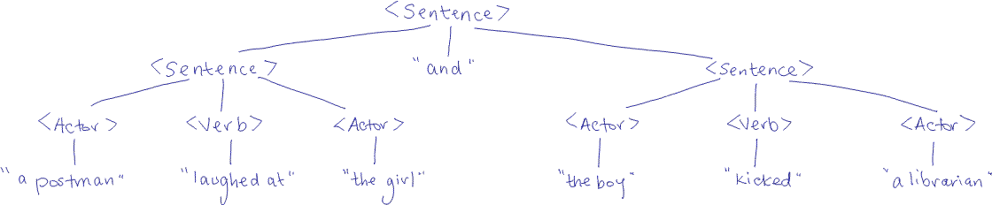
Generative Grammars

Slide 40
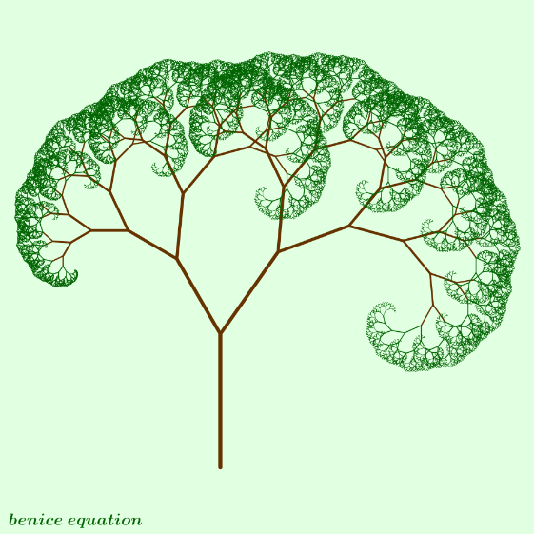
Key Takeaways
Trees are most efficient way to search for data
Balanced trees are most efficient storage model
Power of recursion makes tree management easy
Trees can be beautiful!

